Slide 1
OSCE
7/3/2018
Dr Alex Law
PWH

Slide 2
Question 1
66/M, construction site worker.
Left leg hit by a fallen metal pipe.
c/o severe pain and swelling down from left knee

Slide 3
1. Describe the clinical photo
Left foot and toes are bluish and dusky
Engorged veins
Abrasion wound at left ankle
Left leg skin looks tense

Slide 5
2. Interpret the Xray findings
Normal
3. What is the most likely diagnosis?
Compartment syndrome
4. How to diagnose the above condition?
By clinical diagnosis
Suspect any tense and painful muscle compartment
6 Ps: Pain, Pallor, Paraesthesia, Poikilothermia, Paralysis, Pulselessness
Measuring compartment pressure can help with the diagnosis
Notes:
Pain: -out of proportion to the injury -not relieved by analgesia -increased with passive stretch of compartment muscles (most specific)
Pallor
Paraesthesia
Polar: -cold limb (late finding)
Paralysis (late finding)
Pulselessness (late finding)

Slide 6
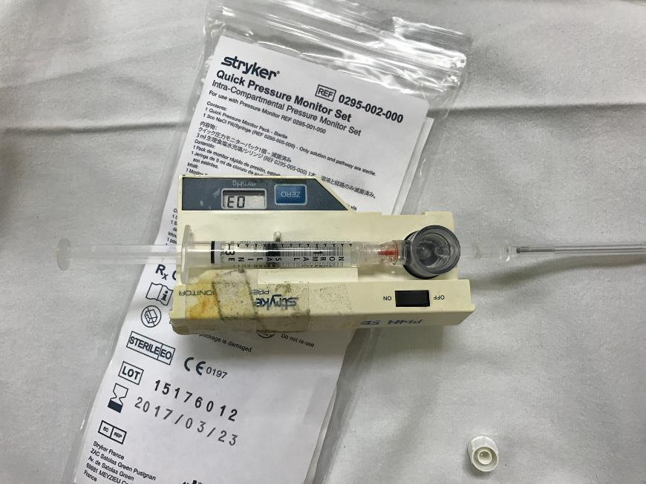
5. What test can help diagnosing the condition? How to interpret the findings?
Compartment pressure measurement
By needle manometer (Stryker device) or slit catheter technique
Normal compartment pressure: 0-8 mmHg
Delta pressure = diastolic blood pressure ‒ measured compartment pressure
delta pressure <20 to 30 mmHg indicates need for fasciotomy

Slide 7
6. What are the treatment options?
The only treatment option is urgent fasciotomy
Exception: non-salvageable limb
Progress:
Compartment pressure (DBP 70mmHg)
Ant: 85
Lat 70
Deep Post: 75
Sup Post: 65
Urgent fasciotomy done; wound closure with split-thickness graft D4
Uncomplicated recovery
Bring home message: absence of fracture does not exclude compartment syndrome

Slide 8
Question 2
40/M, hiker.
Fever x 7/7, headache, malaise
Temp 38.5deg. BP/P stable

Slide 9
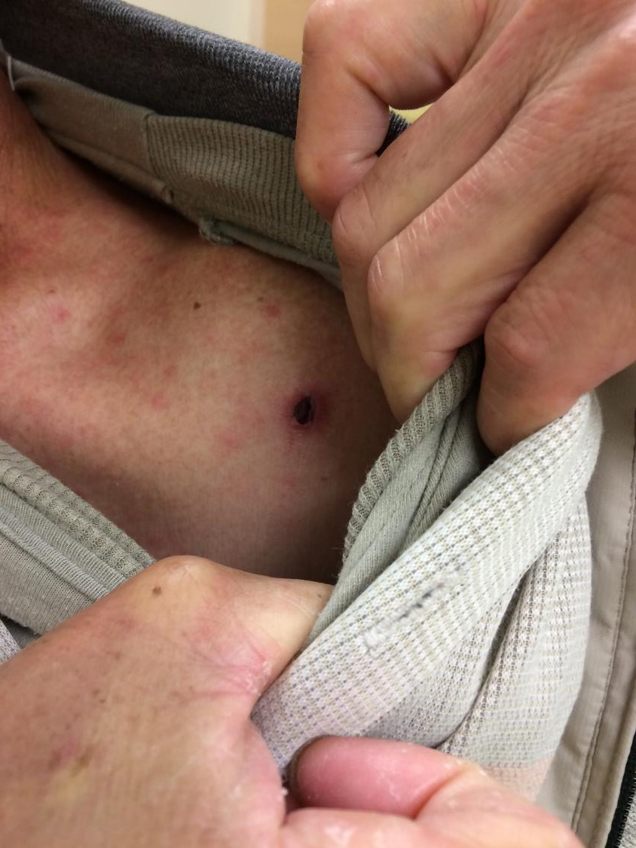
Left shoulder

Slide 10
Describe the clinical photos.
Generalised maculopapular rash over chest and abdomen (typically non-pruritic)
Eschar at left shoulder
What is the most likely diagnosis?
Scrub typhus
What is the pathogen?
Orientia tsutsugamushi (previously called Rickettsia tsutsugamushi)
What is the vector?
Mites/Chiggers ( ext. larval trombiculid mites of the genus Leptotrombidium)
How to confirm the diagnosis?
Serology by indirect fluorescent antibody (IFA) test showing 4x rise in IgG
Alternative: biopsy of eschar, PCR
Weil-Felix not sensitive nor specific

Slide 11
Is it a notifiable disease?
Yes
What is the treatment?
Doxycycline (100mg po or iv bd); alt: azithromycin, chloramphenicol
Duration uncertain: 7days*
What can be the complications of this condition?
Multiorgan failure (including interstitial pneumonia, pulmonary edema, congestive heart failure, circulatory collapse, central nervous system dysfunction, e.g. delirium, confusion, and seizures);
Death (0-30% according to area, strain of infectious agent)
Abortion, stillbirth ( for female patient )
Notes:
Some author suggested only 1 day, but recurrence may be higher

Slide 12
Progress
Serology confirmed O. Tsutsugamuchi infection
Admitted treated with doxycycline x 7/7
Uncomplicated recovery
Bring home message: hiker + fever + rash + eschar = scrub typhus. Timely treatment prevent deadly complications

Slide 13
Similar Rickettsia disease
Disease | Vector | Pathogen
Scrub typhus 叢林斑疹傷寒（恙蟲病） | Mite/chigger 蟎 | Orientia tsutsugamushi
Murine typhus (urban typhus /endemic typhus) 鼠型斑疹傷寒(城巿斑疹傷寒, 地方性斑疹傷寒） | Flea 蚤 | Rickettsia typhi
Epidemic typhus 流行性斑疹傷寒 | Lice 蝨 | R. prowazekii
Spotted fever 斑疹熱 | Tick 蜱 | Rickettsiae spp. of the spotted fever group (> 30 types)

Slide 14
Question 3
34/M, chronic smoker, familial hyperlipidemia defaulted FU
Sudden onset chest pain one hour ago
BP 121/65 P 76/min SpO2 100% RA

Slide 16
Describe the ECG
At V2-3: upsloping ST-segment depression at the J point in leads V1 to V6 that continued into tall, positive symmetrical T waves.
De Winter’s pattern/T waves
What would you do?
Treat as AMI
Send patient to R Room, stabilised ABC
Aspirin 320mg; morphine, nitrate for chest pain
Urgent consult cardiologist
What is the significance of this ECG abnormality?
Considered STEMI equivalent
LAD occlusion

Slide 17
What are the risk factors for this abnormality to occur?
Younger
Male
Hypercholesterolemia

Slide 18
De Winter’s T Waves
an anterior STEMI equivalent that presents without obvious ST segment elevation
~2% of acute LAD occlusions and is under-recognised by clinicians.
Unfamiliarity with this high-risk ECG pattern may lead to under-treatment (e.g. failure of cath lab activation), with attendant negative effects on morbidity and mortality.

Slide 19
2 hours later:
Progress:
Primary PCI done: LAD occlusion with stenting done
Discharged on Day 7
Message: be cautious with patients with severe chest pain and apparently “normal” ECG

Slide 20
Question 4
68/F, GPH
Coughing with whitish sputum x 1/52
c/o brusing on abdomen x 2/7
Stable vitals

Slide 21
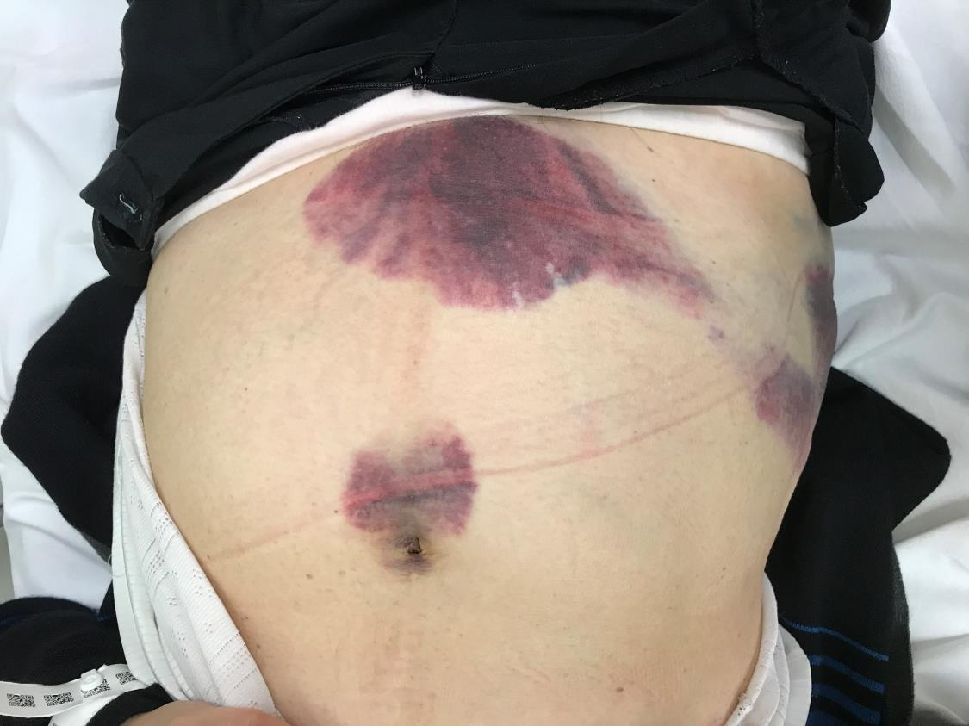

Slide 22
Describe the clinical photos. What are the names of the signs?
Ecchymosis around umbilicus, at suprapubic area and right flank
Cullen sign and Grey Turner sign
In general, what are the possible causes? (not exclusive)
Acute haemorrhagic pancreatitis
Retroperitoneal haemorrhage
Ruptured ectopic pregnancy
Rectus abdominal sheath hematoma
Amoebic liver abscess
Common bile duct rupture and biliary peritonitis
Idiopathic perirenal haemorrhage
Infectious mononucleosis with splenic rupture
Metastatic esophageal cancer
Metastatic thyroid cancer
Non-Hodgkin lymphoma
Portal hypertension

Slide 23
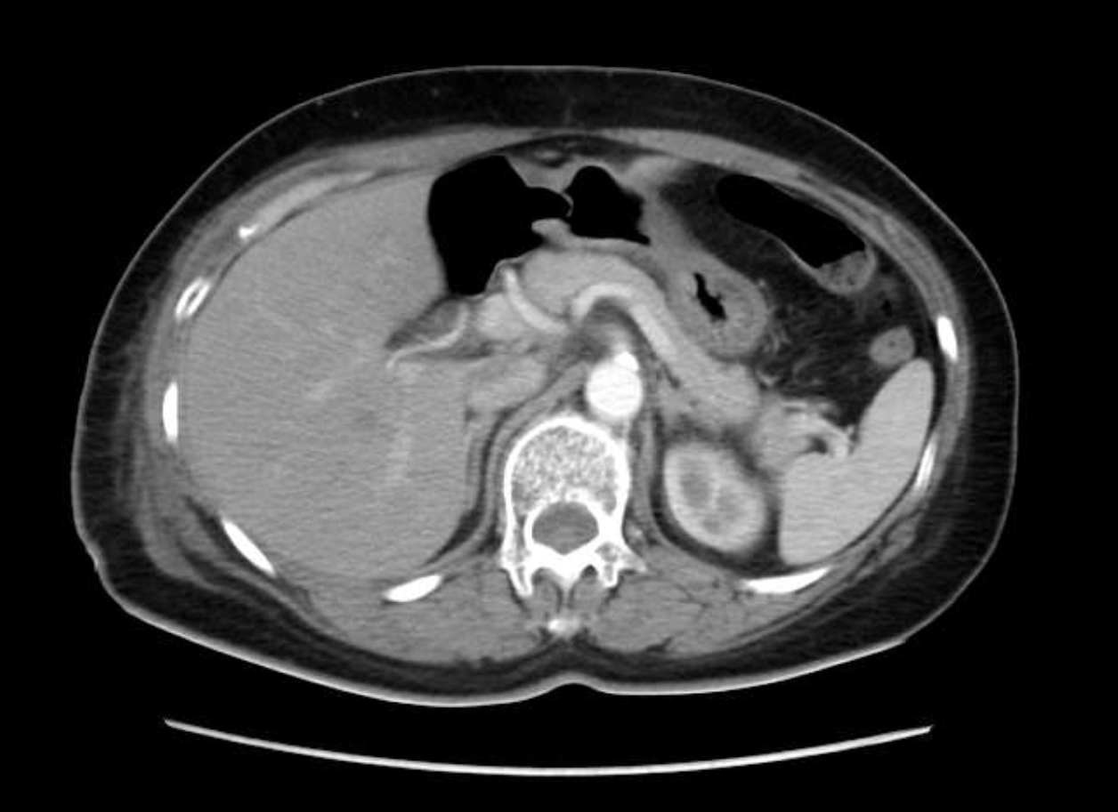

Slide 25
Describe the CT scan findings.
Intramuscular hematoma in right rectus muscle
No sign of active extravasation
If the patient is on dabigatran. What drug can be given?
Idarucizumab (5g bolus)
If patient become unstable despite medical treatment, what can be done?
Surgical ligation of inferior epigastric artery or occulsion by interventional radiology

Slide 26
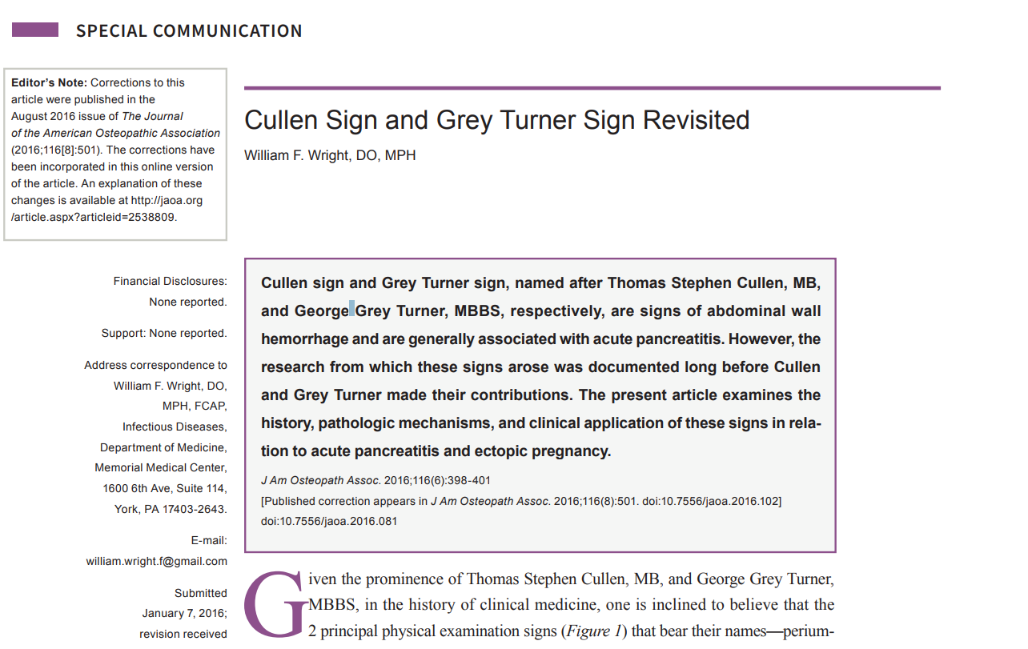
Progress:
Patient treated conservatively,
A follow up USG 1 month later showed resolution of most of the rectus sheath hematoma
Message: Cullen and Grey Turner signs are non-specific and do not always represent hemorrhagic pancreatitis/ ectopic pregnancy

Slide 27
Question 5
39/M, known eczema on TCM
Progressive rash from face to whole body for 1 week
Temp 37.6 BP 126/93, Pulse 87

Slide 28
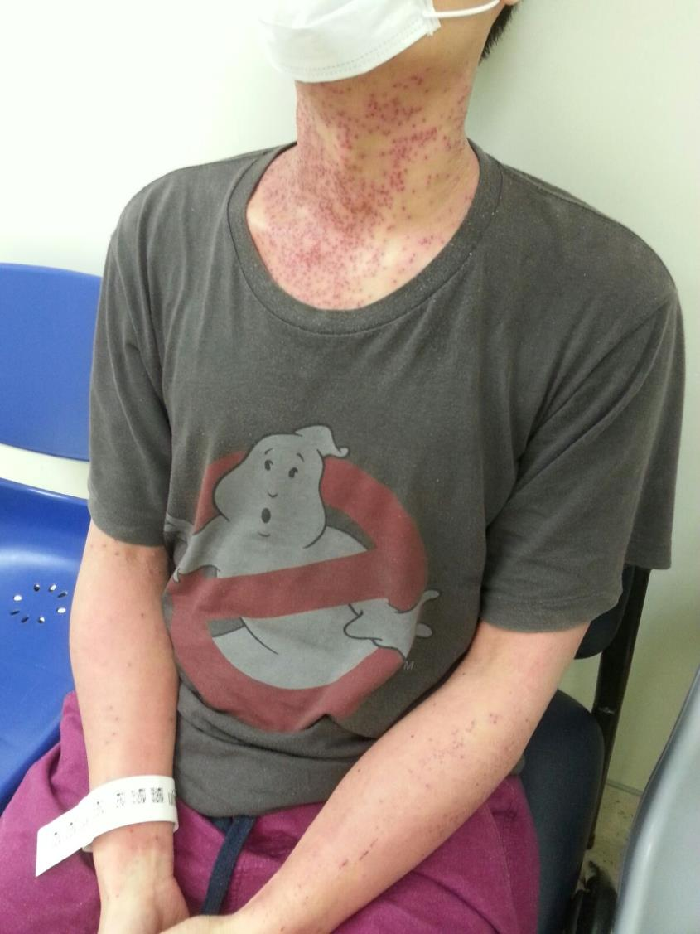

Slide 29
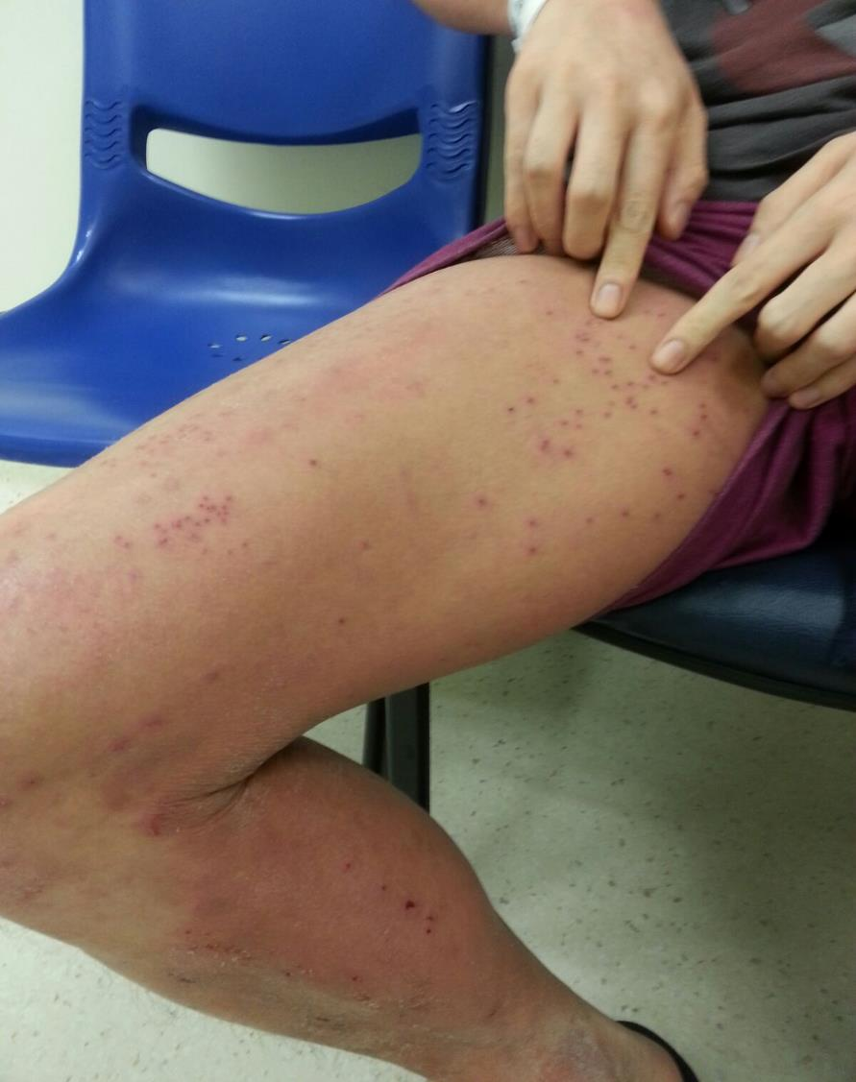

Slide 30
Question 5
Describe the clinical photos.
Generalized punched-out like lesions with surrounding erythema
What is the diagnosis ?
Eczema herpeticum, (also known as Kaposi’s varicelliform eruption)
What is the usual causative agent?
herpes simplex virus type 1 (HSV-1)
How to confirm this condition?
Detection of HSV-1 in vesicular fluid by viral culture, Immunofluorescence staining or PCR

Slide 31
Question 5
Who are at risk of this condition?
Primary dermatological conditions e.g. eczema, pemphigus vulgaris
Severe burns
What would you do?
Admission to medical department and start iv anti-viral e.g. Valaciclovir
HSV -1 infection can spread rapidly leading to severe morbidity and mortality
Notes:
http://www.nejm.org/doi/full/10.1056/NEJMcpc1111572

Slide 32
Progress
Vesicular fluid HSV-1 +ve, VZV –ve
Consulted Dermatology team: Dx is Eczema herpeticum
Given iv Valaciclovir
Skin condition improved, discharged home on Day 8
Message: eczema herpaticum is dermatological emergency, prompt iv antiviral needed

Slide 33
Question 6
48/M, Known DM
Frontal headache and runny nose x 3/7
Found forehead swelling and tenderness on P/E
Vital stable, afebrile

Slide 34
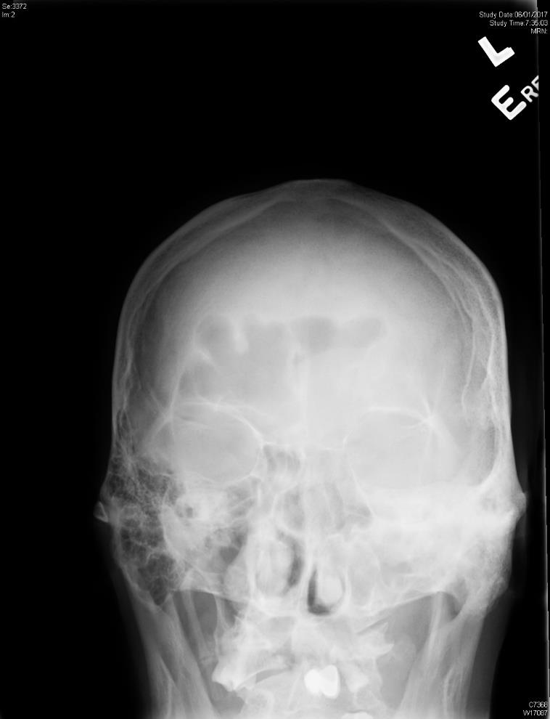
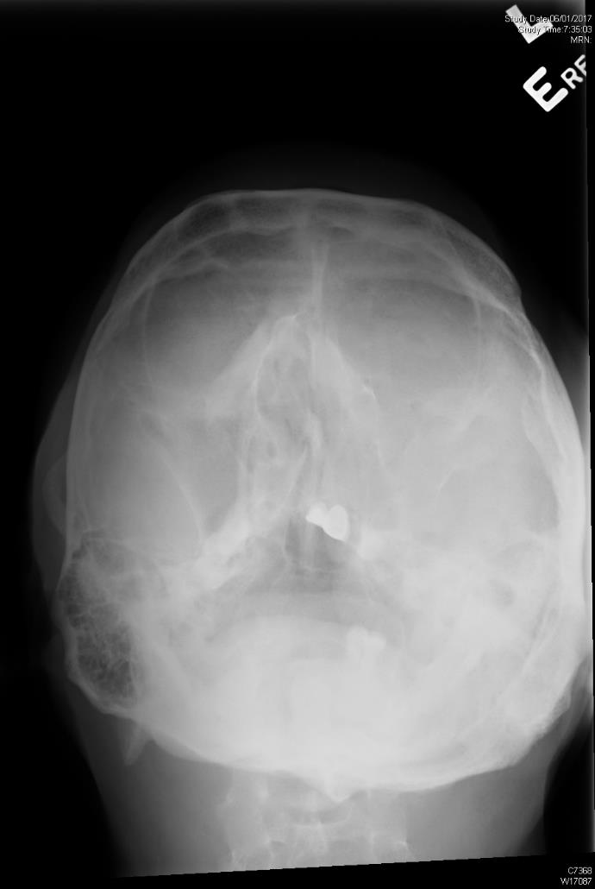

Slide 35
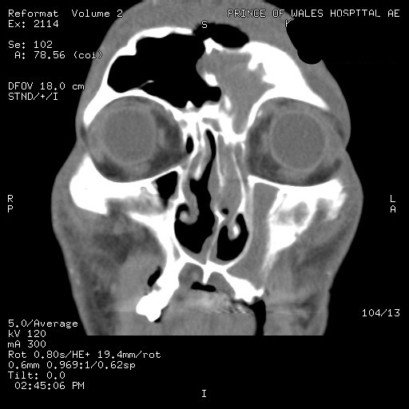

Slide 36
Question 6
Describe the Xray
Air-fluid level seen at left frontal sinus
Air at subcutaneous area anterior to frontal sinus
Opacified left maxillary sinus
Describe the CT scan
Air-fluid level seen at frontal sinuses
Bony dehiscence at anterior wall of frontal sinus with air trapped within soft tissue
Fluid filled left maxillary sinus

Slide 37
Question 6
What is the diagnosis?
Pott’s Puffy tumor
What would you do?
Urgent ENT consultation for urgent drainage
Start iv antibiotics
What are the possible complication?
Intracranial infection e.g. brain abscess, subdural/epidural abscess and meningitis (27.8%)

Slide 38
Progress
Urgent Functional Endoscopic Sinus Surgery (FESS) done on the day of admission.
Pus grew Enterobacter, staphylococci, fusobacterium and anaerobe. Given iv cefuroxime and Flagyl for 3/52. Uncomplicated recovery.
Message: Pott’s puffy tumour ≠ ordinary sinusitis. It is a ENT emergency, iv antibiotics and urgent drainage necessary
Notes:
https://www.jstage.jst.go.jp/article/jnms/83/5/83_211/_pdf/-char/en

Slide 39
Thank you!
Acknowledgement: Dr. KB Wong, Dr. NH Chu

